Slide 1

Regularization
Michigan Hackers Machine Learning Team

Slide 2

Today’s Agenda
Announcements
Icebreaker
Roadmap
Review of Logistic Regression
Introduction to Regularization
Iris Classification Project Introduction
Work and Ask Questions

Slide 3
Announcements
MDP Project Application Deadline has been extended to Tomorrow 11:55 pm.
One application for 47 projects (research, industry, arts. This is a great opportunity to get industry or research experience during the school year
Google Kickstart
Become a Core Member!

Slide 4

Ice Breaker
Question of the Week: What MDP Projects have you applied for?
Do any of them have something to do with Machine Learning?

Slide 5
Roadmap
Iris Species Classification (Logistic Regression)
Kaggle Titanic Project
Regularization
Random Forests
Neural Networks
After neural networks: deep learning, computer vision, reinforcement learning, SVMs, sentiment analysis

Slide 6
Python Progress Check
Goal: Complete Course 3 of the Python 3 Programming specialization (Data Collection and Processing with Python)
Next Step: Work through Pandas Python Library for Beginners in Data Science

Slide 7
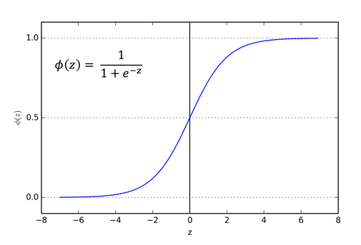
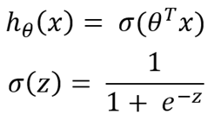
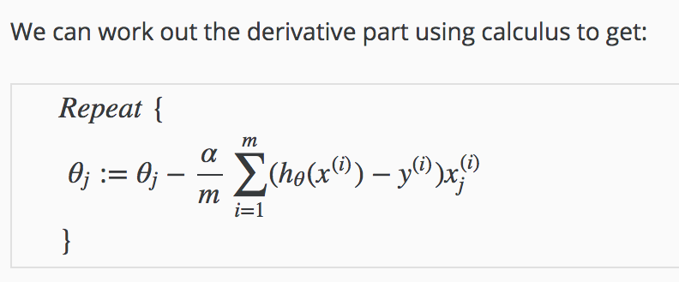
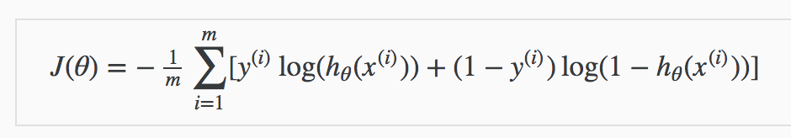
One Slide Review of Logistic Regression
Logistic Regression Model: A classification algorithm that predicts the probability of a data point being in a desired class using the sigmoid function.
Hypothesis Function
Gradient Descent
Cost Function

Slide 8

Logistic Regression in Python

Slide 9
Regularization

Slide 10
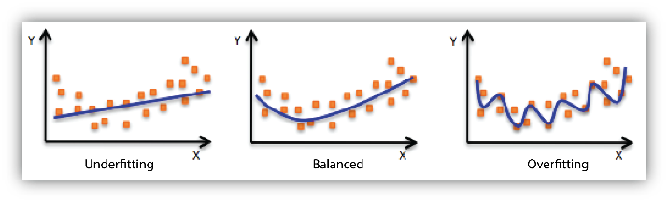
Overfitting vs Underfitting
Model Complexity: the number of terms/features included in a given predictive model. Whether the chosen model is linear, polynomial, nonlinear, and so on.
Noise: the data points that don’t really represent the true properties of your data, but random chance.
Overfitting: a model is too closely fit to the training data set; too complex.
Underfitting: a model is too loosely fit to the training data set; too simple.

Slide 11
The Bias/Variance Trade-Off
Bias is the difference between the average prediction of our model and the correct value which we are trying to predict. Model with high bias pays very little attention to the training data and oversimplifies the model. It always leads to high error on training and test data.
Example: A linear model will have higher bias than an extremely flexible model
Variance is the variability of model prediction for a given data point or a value which tells us spread of our data. Model with high variance pays a lot of attention to training data and does not generalize on the data which it hasn’t seen before. As a result, such models perform very well on training data but has high error rates on test data.
Example: A linear model will have less variance than an extremely flexible model
A general rule is that, as a statistical method tries to match data points more closely or when a more flexible method is used, the bias reduces, but variance increases.

Slide 12
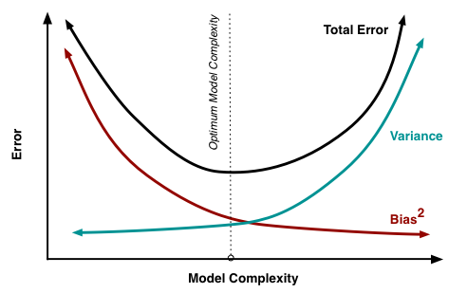
The Bias/Variance Trade-Off Visual

Slide 13

Regularization
Regularization is a technique used for tuning the function by adding an additional penalty term in the cost function. The additional term controls the excessively fluctuating function such that the coefficients don't take extreme values, so as to avoid the risk of overfitting.
A common cost function is Residual Sum of Squares:
If there is noise in the training data, then the estimated coefficients won’t generalize well to the test data. This is where regularization comes in and shrinks these learned estimates towards zero.

Slide 14

Ridge Regression
The penalty function in Ridge Regression is the sum of the squared values of coefficients of the predictive model.
Lamba, λ is the tuning parameter that decides how much we want to penalize the flexibility of our model.
When λ = 0, the penalty term has no eﬀect, and the estimates produced by ridge regression will be equal to least squares. However, as λ→∞, the impact of the shrinkage penalty grows, and the ridge regression coeﬃcient estimates will approach zero.
The coefficient estimates produced by this method are also known as the L2 norm.

Slide 15

Lasso Regression
The penalty function in Lasso Regression is the sum of the absolute values of coefficients of the predictive model.
Lasso differs from ridge regression only in penalizing the high coefficients.
The coefficient estimates produced by this method are also known as the L1 norm.

Slide 16
Regularized Logistic Regression

Slide 17



Regularized Cost Function for LogReg
Error function
Simple Cost Function
Ridge Regression

Slide 18


Gradient of Regularized Cost Function
Gradient of Simple Cost Function
Gradient of Reg. Cost Function

Slide 19
Regularized Logistic Regression in Python

Slide 20

Iris Species Classification Project

Slide 21

Iris Species Classification Project
Project folder
Contains project spec and submissions folder

Slide 22
Work and Ask Questions
Iris Classification Project
Regularized Logistic Regression
Coursera: Pandas Python Library for Beginners in Data Science
Continue with Python
Beginner: Complete through Course 3 of the Python 3 Programming specialization. Use the practice feature of the interactive textbook
Intermediate: Read Chapters 16 in DSFS.
Experiences:

Slide 23
Thank You!
Michigan Hackers Machine Learning Team
Contact Info:
Rajas Gupta | rajasg@umich.edu
Vijay Shamra | vsharm@umich.edu
Provide Feedback

